Slide 1
Introduction to R Workshop
Amrom Obstfeld
August 16, 2020

Slide 2
Course Introduction

Slide 3
Goals and Objectives
Advocate for the use of R as a means of improving reproducibility in clinical data analysis
Demonstrate how R is used to perform analyses of laboratory operational data
Establish a basis of understanding in the 'tidy' approach to data analysis within the framework of R

Slide 4
Who are we?

Slide 5
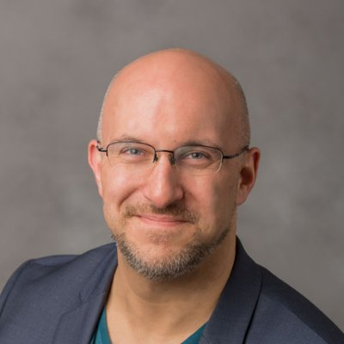
Stephan Kadauke
Assistant Professor of Clinical Pathology and Laboratory Medicine
University of Pennsylvania Perelman School of Medicine
Assistant Director of the Cell and Gene Therapy Laboratory
Children's Hospital of Philadelphia
Notes:
Stephan Kadauke, MD, PhD is an Assistant Professor of Pathology and Lab Medicine at the Children’s Hospital of Philadelphia where he is the Assistant Director of the Cell and Gene Therapy Lab. He leads the Cell and Gene Therapy DataOps group which builds and deploys predictive models and other data products for the care of children who receive bone marrow transplants and other cell therapies.

Slide 6
Daniel Herman
Assistant Professor of Pathology and Laboratory Medicine
University of Pennsylvania Perelman School of Medicine
Director, Endocrinology Laboratory
Hospital of the University of Pennsylvania
Notes:
Daniel S. Herman
Assistant Professor of Pathology and Laboratory Medicine, University of Pennsylvania; Director of Endocrinology, Hospital of the University of Pennsylvania
PHILADELPHIA, PA | daniel.herman2@pennmedicine.upenn.edu
Daniel Herman practices clinical pathology at the University of Pennsylvania, where he directs the Endocrinology laboratory at the Hospital of the University of Pennsylvania. He completed his MD and PhD degrees at Harvard Medical School and trained in Clinical Pathology at the University of Washington. His current clinical practice, in addition to clinical chemistry, includes leading informatics projects to make better use of existing laboratory data in the form of live operational dashboards, test utilization reports, and identification of missing patient diagnoses.
His research group has been developing EHR-based methods to improve population health screening, focused recently on improving population hypertension management by identifying patients with undiagnosed primary aldosteronism. He is also interested in the intersection of pathology and policy and currently serves as College of American Pathology State Issue Advisor for Pennsylvania.

Slide 7
Amrom Obstfeld
Assistant Professor of Clinical Pathology and Laboratory Medicine
University of Pennsylvania Perelman School of Medicine
Director of Pathology Informatics
Children's Hospital of Philadelphia
Notes:
Amrom Obstfeld MD, PhD, is the Medical Director of the Division of Pathology Informatics directs the Hematology and Coagulation Laboratories at Children’s Hospital of Philadelphia. In this role Amrom leads the development of analytic tools to aid in laboratory quality management, administration, and operation, supports the deployment of new IS infrastructure in pathology and interfaces with other groups throughout the hospital on informatics initiatives. Dr. Obstfeld plays a major role in designing and implementing educational experiences for pathology trainees and faculty at the University of Pennsylvania within the areas of clinical and pathology informatics.

Slide 8
Workshop Workflow
Notes:
So now that you've met us let's discuss for a moment how this workshop is going to work

Slide 9
August 16 2020 | Session | Instructor
9:00 am - 9:30 am | Instructor Introductions, Introduction to technology | Amrom Obstfeld
9:30 am - 10:15 am | Introduction to R and RStudio | Amrom Obstfeld
10:30 pm - 11:15 am | Reproducible Reporting | Amrom Obstfeld
11:30 am - 1:00 am | Data Visualization | Stephan Kadauke
August 23 2020
9:00 am - 10:30 pm | Data Transformation | Amrom Obstfeld
10:45 am - 12:15 pm | Statistical Analysis | Dan Herman
12:30 pm - 1:00 pm | Workshop Close out | Amrom Obstfeld

Slide 10
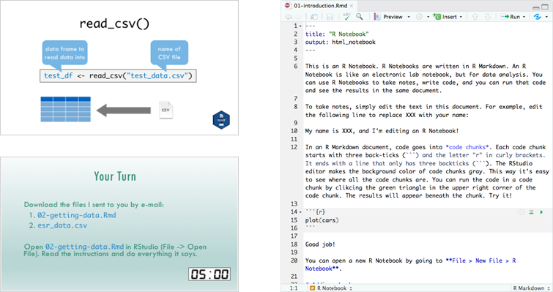
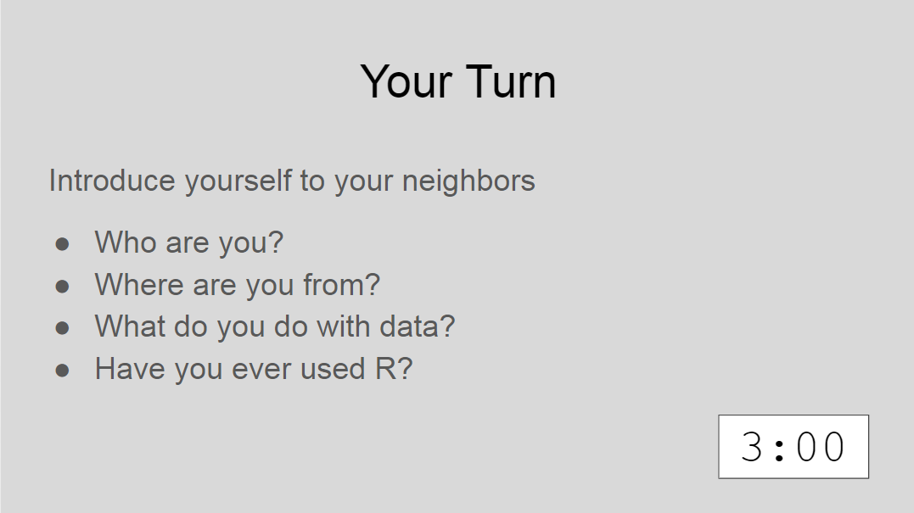
Sessions
Notes:
The meat of the workshop are the sessions each of which we will cover discrete subjects or components of R in a data analysis. The sessions have a powerpoint associated with it as well as an R script.
We'll be describing a specific function or topic in the context of the powerpoint – all of which are included in the coursebook and available for download. The same code that is being demoed is included in the R script and you are invited to follow along, run the code, play with it if you like.
At several points in the session we'll have you engage in some exercises which we call Your Turns. In a Your Turn we'll assess how we're doing by asking you to critically think about the topic in the session and respond to a question or do some coding on your own. We'll speak a bit later about how these coding exercises will work.

Slide 11
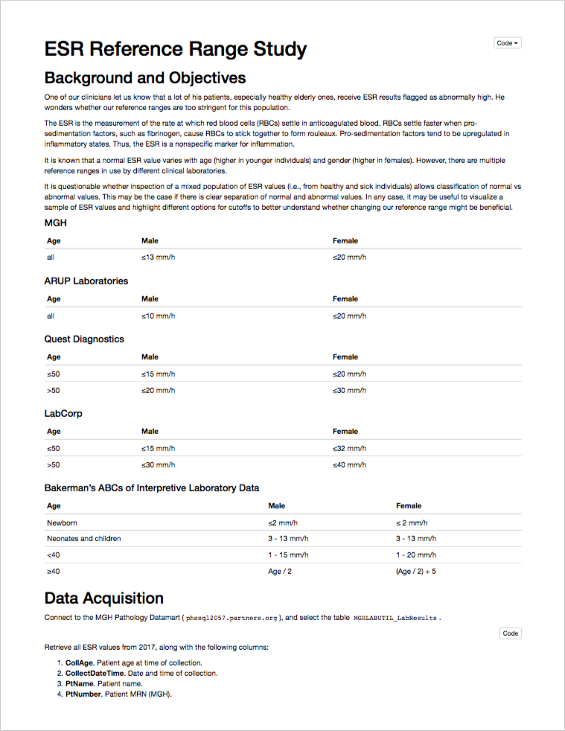
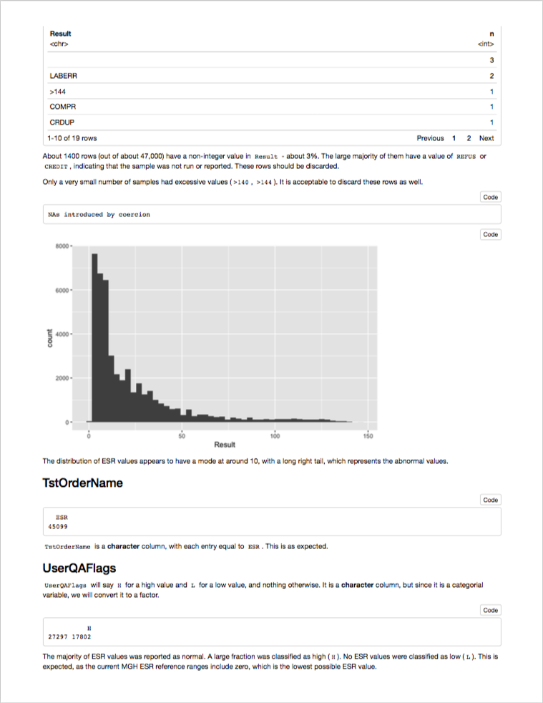
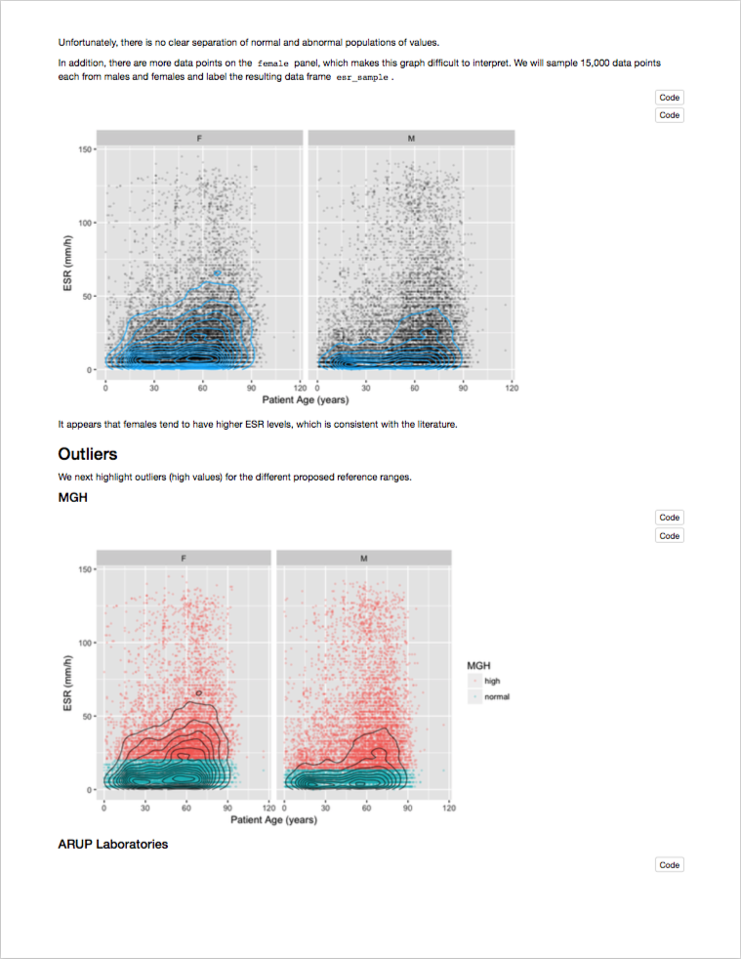
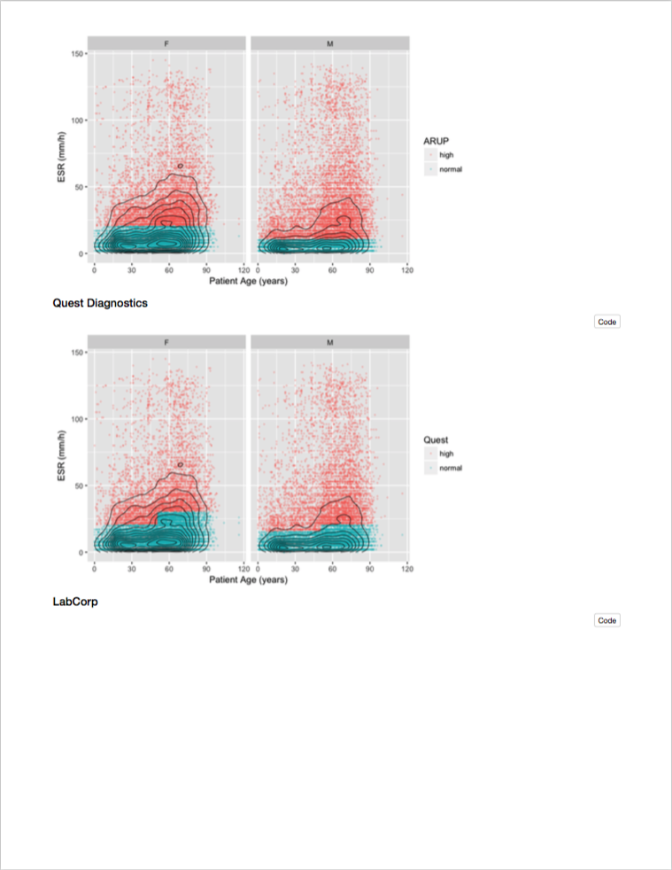
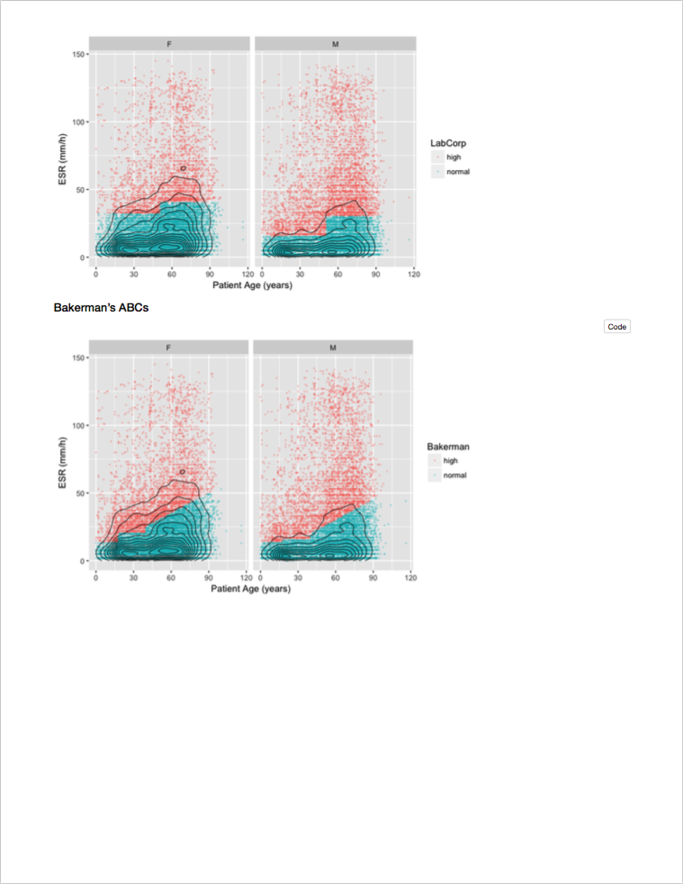
Course Project
Notes:
Together, these in-class activities should get you to a point where you can follow along a reproducible report that’s created in R. However, you won’t learn how to do your own reproducible analysis unless you actually do your own analysis. That’s the purpose of the course project.
Do you have to do a course project? No – this course and any part of it is completely voluntary. But you will get so much more out of this course if you do. I would go so far as to say that sitting through this workshop and then NOT doing a course project is kind of a waste of time. So I hope that all of you are going to do a course project.
Course projects will be presented in a separate session in about 4-6 weeks from now. We’ll schedule a time that works for everyone.
For the course project you will want to start with a question that broadly relates to an aspect of quality of care or clinical research. You will then write the code to load a relevant data set into R and create a graph or a statistical summary that addresses the question. Since all the computer code is inside the report, that automatically makes it reproducible. We’ll look at how this works in much more detail.
For example, here is a reproducible report that examines ESR results, taken straight out of CERNER. You can see that there’s a section that defines the question, a section that specifies the data source, and a section that explores the data and cleans it up, if necessary.
* Finally, there’s a section labeled “Visualization and Modeling” that attempts to answer the question, what’s the variability of ESR by age and gender, graphically.

Slide 12
Hackathons
Participants work with experienced R users on the course project
Helps troubleshoot problems
Practice collaborating on analytics projects
Notes:
Now we're not going to leave you out to dry, we're going to be here with you every step of the way.
In the past one of the major ways we in the past we try to assist you is thru hackathons.
In a hackathon you have the opportujnity to bring that project that you're working on and get help with any problems you may be having.
We usually have three, you don’t have to come to all or any of them, they are really for you to get help
Now in this environment im not sure that this is going to really work out the way that it usually does, its usually actually a lot of fun, with a lot of ppl hanging out and chatting
this year we may have to do this as set one on ones with instructors

Slide 13

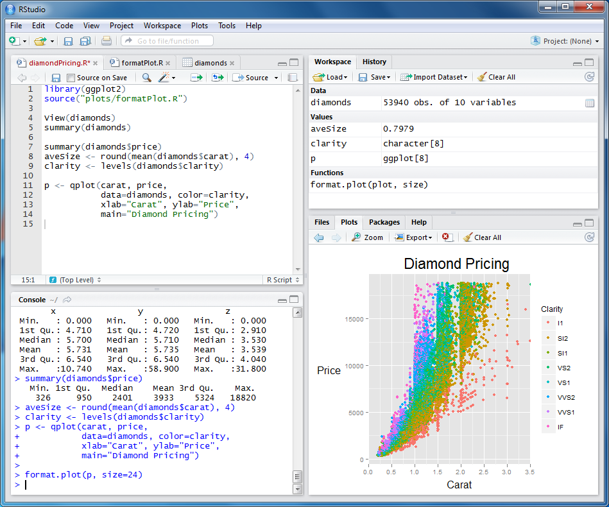
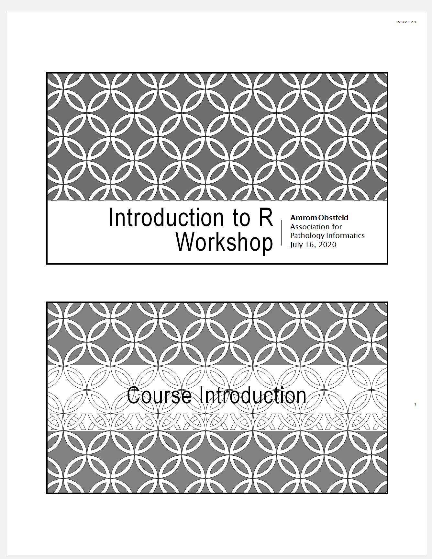
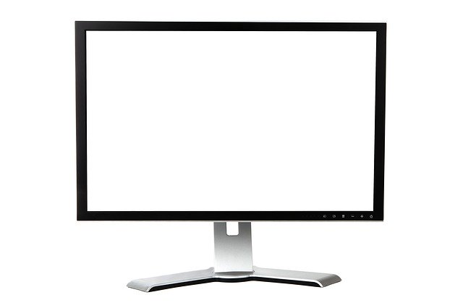

Your Setup
1
2
Notes:
These are the resources that you should have access to during this workshop.
Ideally you have zoom open on one of your monitors, you have a second monitor in which you will be opening up the Rstudio cloud application, we haven’t gotten to that yet so don’t worry about that yet
And third you should have the PDF of the course book available to you at your desk.
We of course understand that not everyone has two monitors, not anyone has the capacity to print out a few hundred pages of the course book, so if you have a tablet and can use Zoom on it, we encourage you to open up the zoom there and at least have the PDF of the course book open on your computer as well.

Slide 14
Workshop Coursebook
Print out of all slides
Appendix
Cheat sheets
Useful resources
Notes:
The coursebook has all the session powerpoints as well as an appendix that has some additional resources
Cheat sheets are concise one or two page documents that you can use as a quick reference. we'll be referring to these during the sessions. They are also easily googlable and available through the help menu in Rstudio. There is also a one page Useful resources document with links to free online resources like textbooks, videos and courses.

Slide 15
Using Zoom
Participants muted
Chat window
Non-verbal feedback
Breakout sessions
Notes:
Let’s talk a little bit about how we'll be using zoom in this workshop.
During the sessions everyone will be muted other than the instructor. That doesn’t mean that there won’t be opportunities for engagement, we want to make sure that this is an interactive workshop and not an experience that only has communication going in one direction
We will be using the chat window in Zoom we will also be using some nonverbal feedback modalities and we'll have breakout sessions during which we'll be doing exercises together in an interactive way, more about all this in a few moments.
So let’s try out some of these features of zoom that you may not be familiar with →→

Slide 16
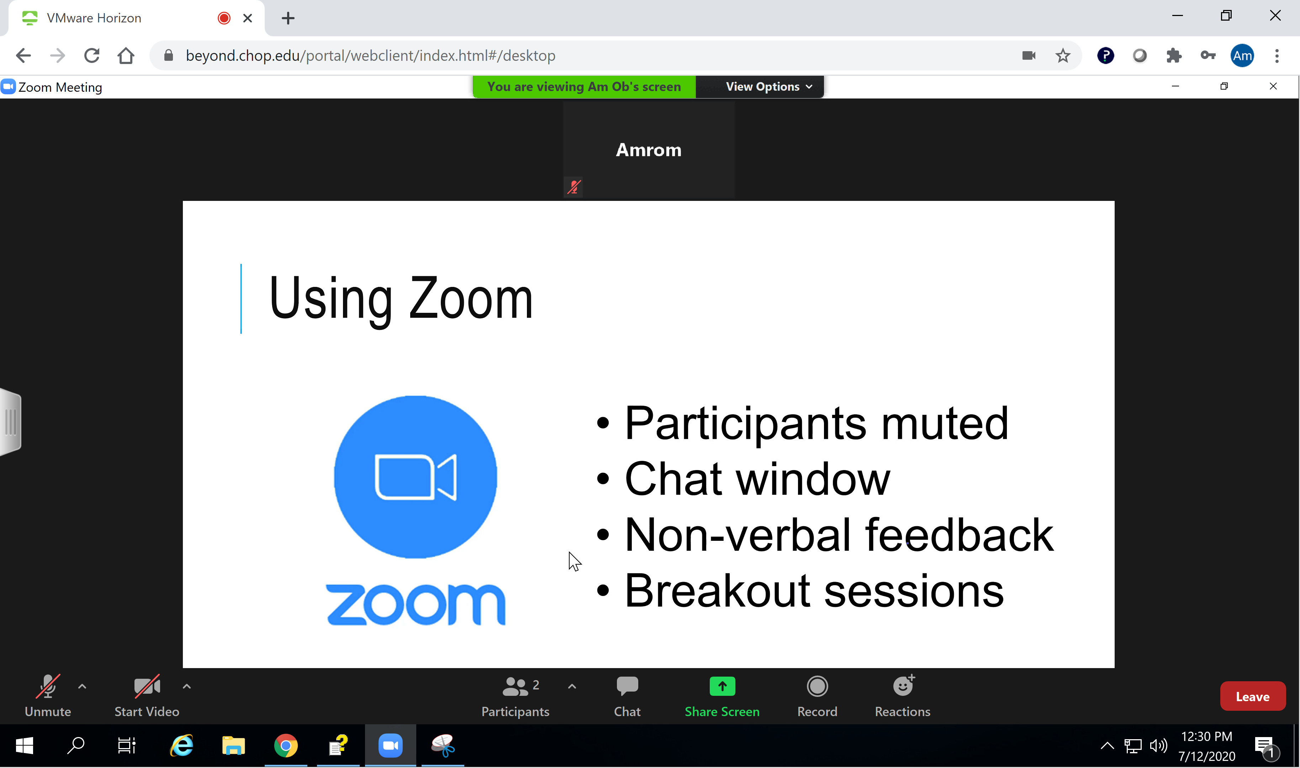
Notes:
This is more or less what you should be seeing on your screen.
At the bottom of the Zoom window you’ll notice a tab called Participants and a tab called Chat
You want to make sure you have access to both of these. If there not already open, click on both of those tabs and you should get a pop-up window that has a list of all of the participants that are in the workshop and a Pop up Chat window.
If those pop ups appear docked on the right side of your Zoom window then you’re in good shape. If they appear as free-floating windows you’re going to need to tell zoom to dock it over on the right. The best way to do this is by taking yourself out of Full screen view. At the top of your zoom window you should see something that says view options click there and then click exit full screen that should trigger zoom to dock your participants went out after the right. Worst comes to worst, you can always manually drag those windows to the side yourself.
Ill give everyone a minute to work through that.

Slide 17
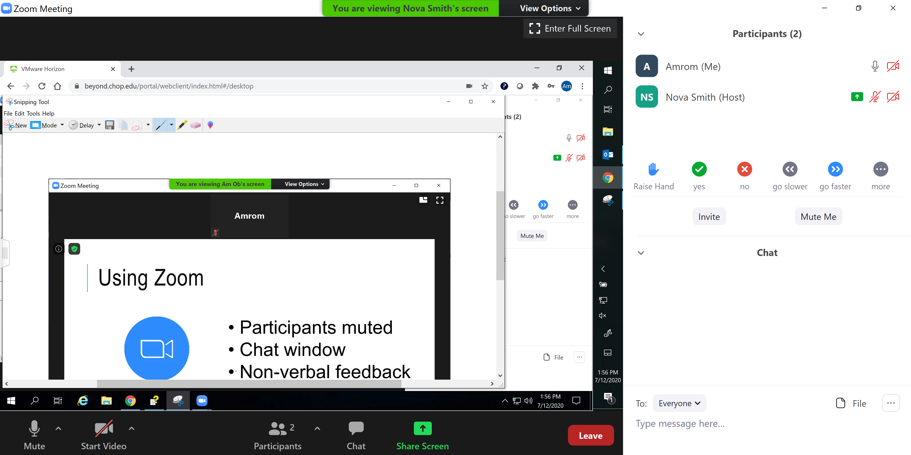
Notes:
If you were successful you should now have a participants and chat window off to the right.
--Don’t get confused here this is my side bar and this is your side bar.
You'll notice on the bottom of the Participants Pane that there are several icons, Raise Hand, Yes, No, and so on.
If you have the participant in pane open and have access to these icons do us a favor and press the YES icon. You’ll see that a yes appears right next to your name. Let me give you guys a minute to get that yes button clicked.
---
OK looks like you guys were able to do it, As the host I can clear all these icons out like this. Every so often we'll ask you for some non verbal feedback to make sure we're all together.
---
Occasionally we'll want to elicit a bit more than yes or no, that's where the chat window comes in. By default these chats will be going to everyone, you do have the option to send direct messages. Let’s see if you can use the chat window. A word of warning don't try sending a DM to the presenter since they won't be able to respond, so by default just leave this set to everyone. Why don’t we all type in to the chat window where in the world we're connecting from.

Slide 18
Getting Help
During presentation – Raise hand, instructor will DM
Break out sessions – Instructor available, unmuted
Notes:
During the workshop sooner or later you’re likely going to need some help.
If you find yourself having a question or needing assistance during a presentation what we’re asking you to do is to go over to the participants window and click the raise your hand icon. This can be found in the bottom of the participants pane. We will have intermittent stops in the action and we'll go to that window and just elicit these questions.
If need be we can make use of break out sessions. In a break out session one of the instructors will work with you one on one and you'll have the opportunity to present your screen so we can see exactly whats going on.
There may be issues that are just too challenging to handle in the context of a virtual workshop. If that does occur we’re going to ask you to make a note of the issue, try to keep with the workshop, and hopefully we can find a way to take it off line.

Slide 19
Who are you?
Notes:
So, now that you've learned a bit about us and how this is all going to work, let's find out a little bit about you
→

Slide 20

Your Turn
Introduce yourself!
Who are you?
Where are you from?
Why are you here?
Have you ever used R?

Slide 21
When you need more help
The Internet (Stack Overflow: https://stackoverflow.com/)
Work Aids (RStudio Cheat Sheets: https://www.rstudio.com/resources/cheatsheets/)
A Good Book (R for Data Science: http://r4ds.had.co.nz/)
Notes:
Sometimes you will need more help than the R help feature provides.
There are many wonderful freely available resources on the internet to assist you.
Chances are others have tackled similar challenges. A quick internet or forum search can often provide an answer.
The folks at RStudio have developed a number of cheat sheets which are great references. Many of us keep printed copies of these near our desks for the features and tools we use most.
Also, there are a number of great reference books out there. One of our favorites is R for Data Science. It is freely available online and print copies are available also.

Slide 22
Final Tips
The best way to learn to code is by doing
Practice is key!
Notes:
And just some final words before we begin, no matter what you're learning but particularly coding, the best way to learn is by doing:
Find a project, make a goal for yourself, push yourself to use R, it's OK to lean on some excel, we all do when we're starting out, but try to get that activation energy to get your hands typing code. We would not be teaching this course if we didn't strongly believe that R is accessible to all of you. So keep practicing and you'll get there.
With that let's get started with the workshop. Up next Joe will provide us with the basics of R and get us up and running with Rstudio Cloud.

